Slide 1


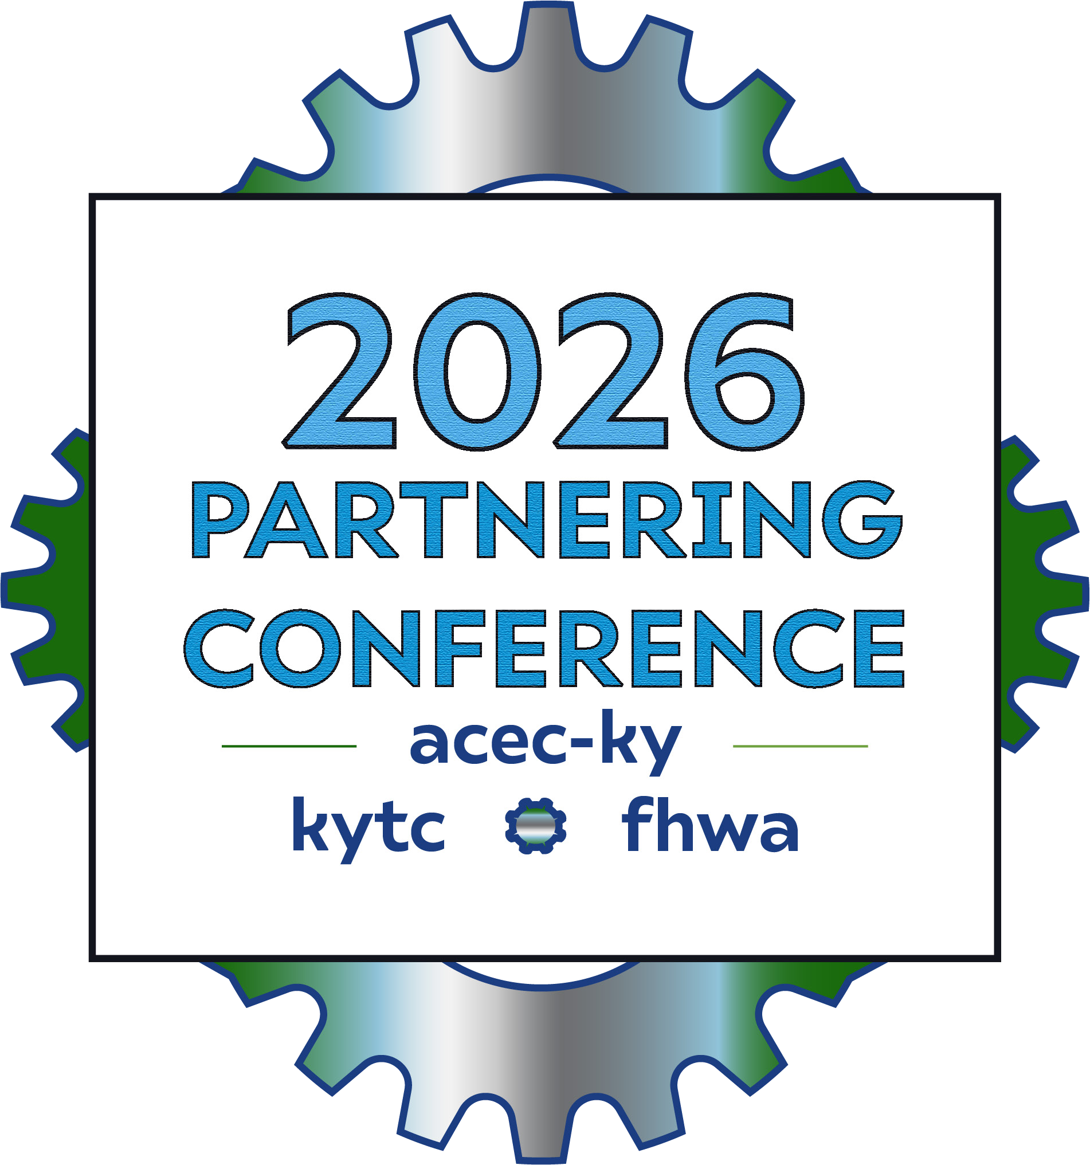
I-65 Central Corridor Project
KYTC’s 1st CM/GC Project
Thursday, September 10th

Slide 2


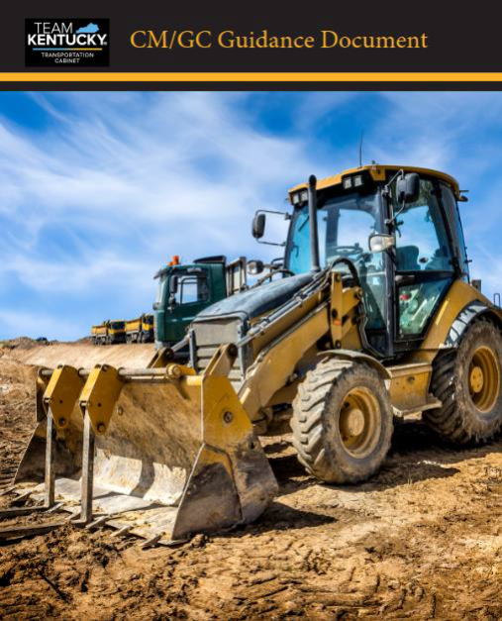
What is CM/GC?
In CM/GC, the Cabinet procures a contractor based on qualifications to provide input during the Preconstruction Phase of the Project as well as to construct the Project. During the Preconstruction Phase, the Contractor provides constructability input to the Cabinet on matters such as constructability, risk, cost, and construction schedule optimization.
KYTC Contact:
Erika Drury, PE
Alternative Delivery Program Manager

Slide 3


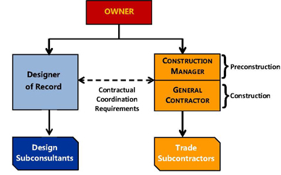
Construction Manager/General Contractor
(CM/GC)
Note: Image from FHWA Website

Slide 4
Construction Manager/General Contractor
(CM/GC)
KYTC
AECOM
KIEWIT
QK4
CDI

Slide 5
Project Overview

Slide 6

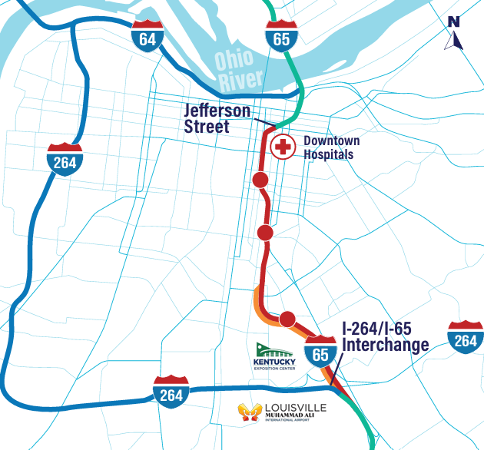

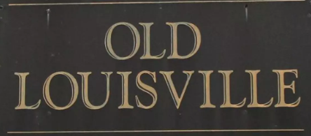




Location Map – I-65 Central Corridor
I-65 Project Website
https://i65centralcorridor.com

Slide 7
Location Map – I-65 Central Corridor
I-65 Project Website
https://i65centralcorridor.com

Slide 8
Location Map – I-65 Central Corridor
I-65 Project Website
https://i65centralcorridor.com

Slide 9

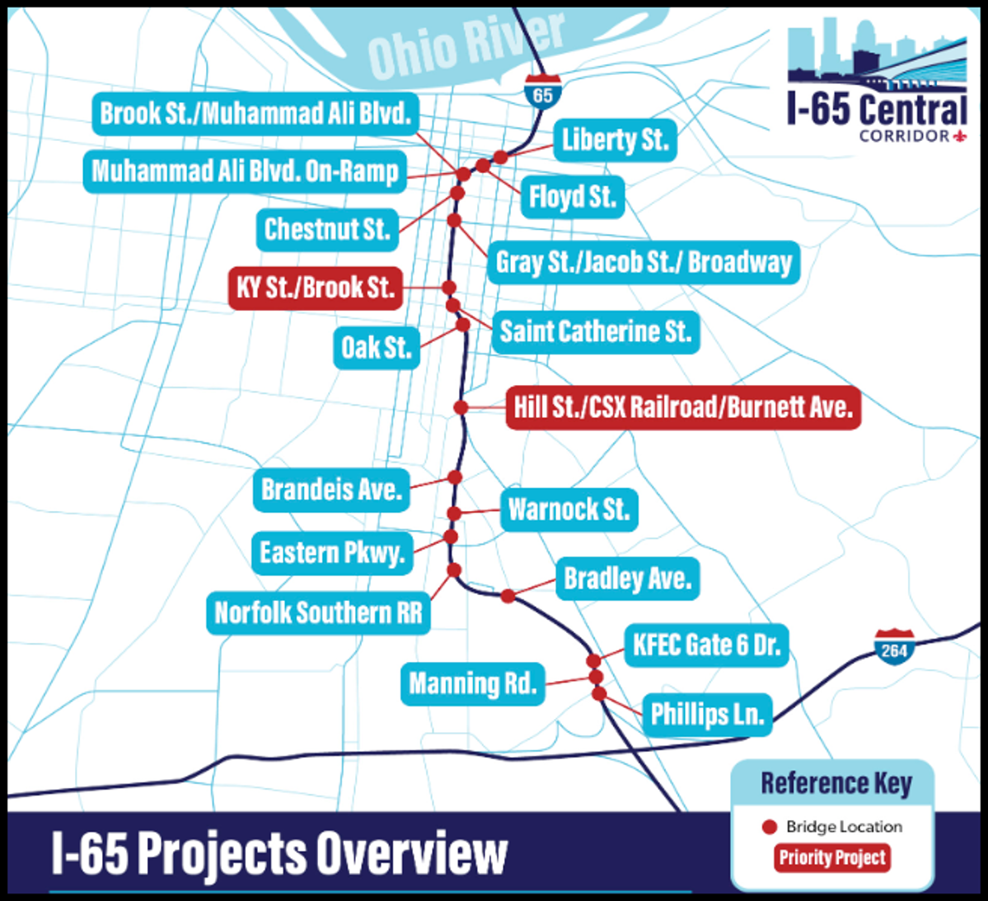
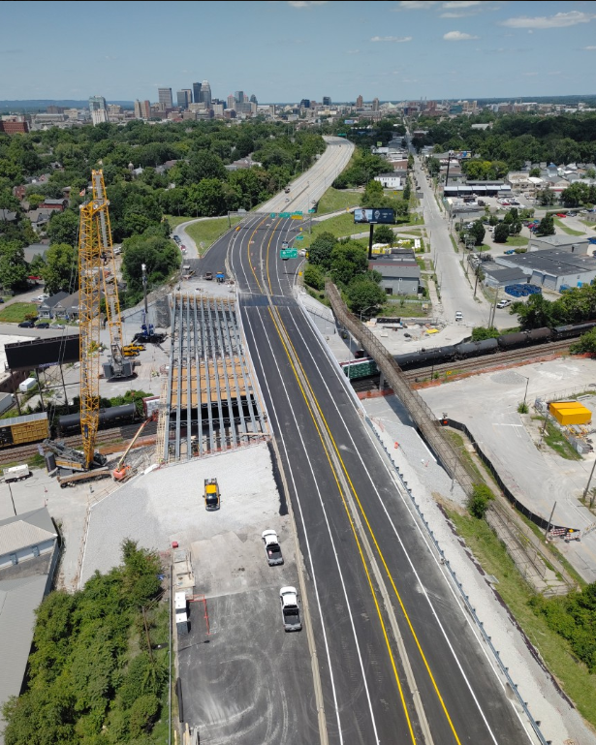


18 Bridges + Pavement Rehab
Bundle #1
Bradley Ave
Notes:
30% Plans on all 18 bridges. RFC Plans on 9 bridges.

Slide 10
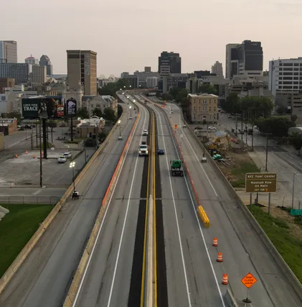
18 Bridges + Pavement Rehab
Bundle #2
Bradley Ave
Notes:
30% Plans on all bridges.

Slide 11
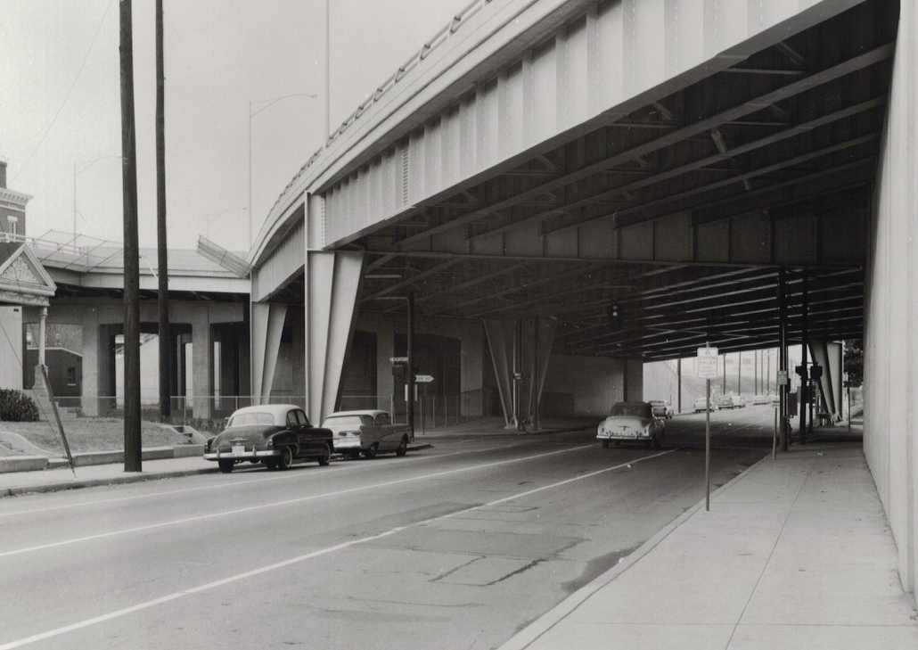
Creating Opportunities from Challenges
High Traffic Volume
Complex MOT Planning/Design
Restricted Urban Corridor
Limited Existing ROW
High-cost commercial properties
High Profile Stakeholders
Historic Districts
Medical Districts
Colleges/Universities
Kentucky Expo Center / Fairgrounds
Utilities (active & abandoned)
Existing Bridge Geometrics
Complex Bridge Design
Unique Details and Special Design
“Another first on a project with many firsts”
~ Adam Ross - KYTC

Slide 12
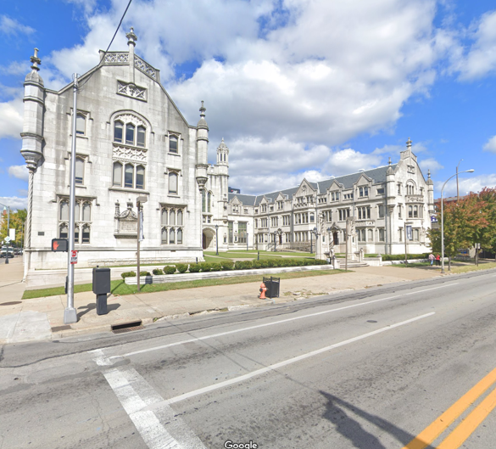
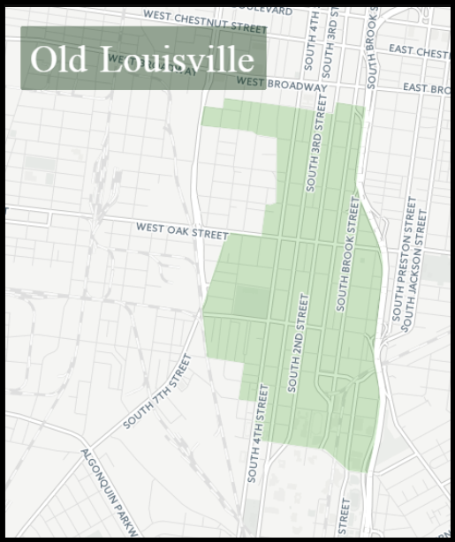
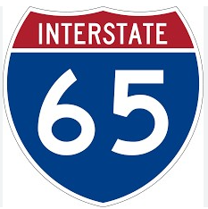
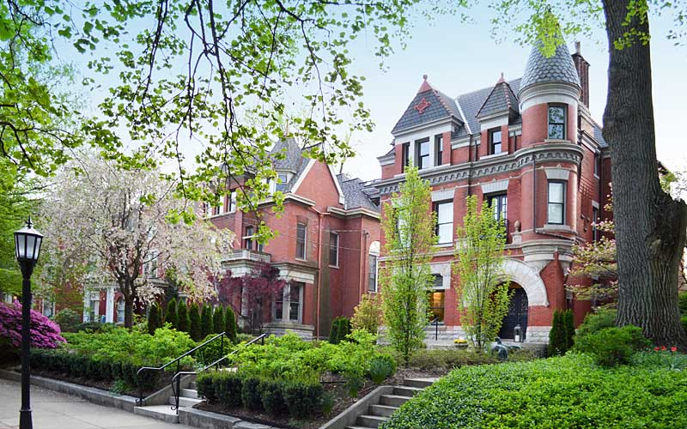
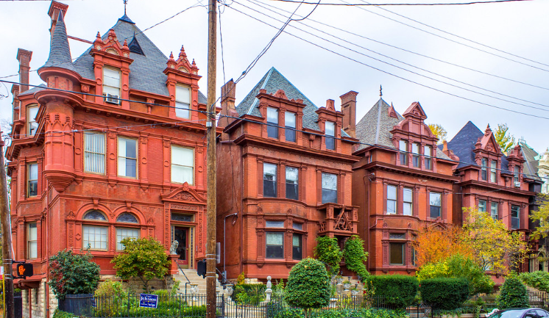

I-65 Central Corridor Setting | Historic Districts
Old Louisville is the 3rd largest Historical Preservation District in the U.S. given its number of restored Victorian homes.
Seminary Hall – Broadway

Slide 13

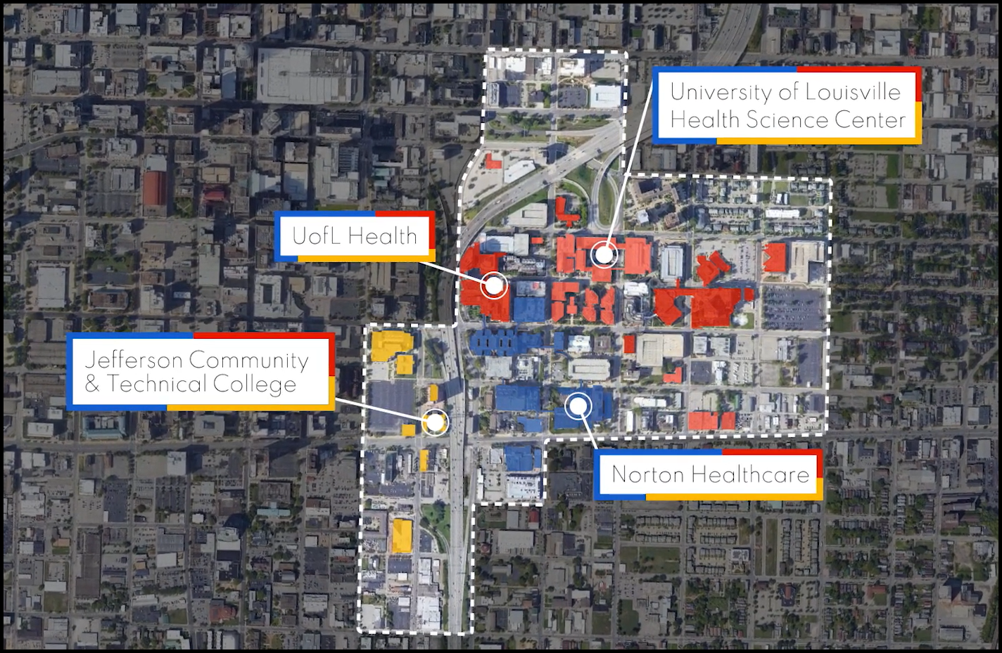
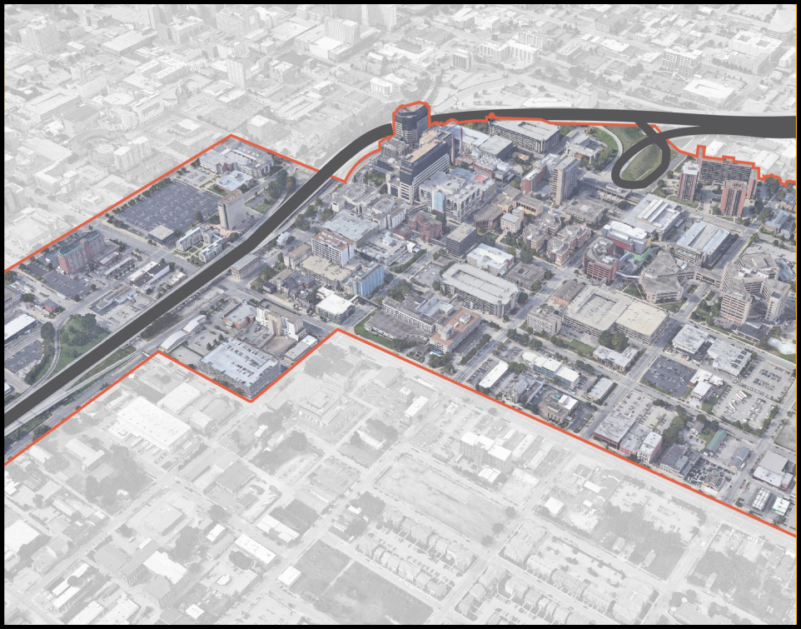
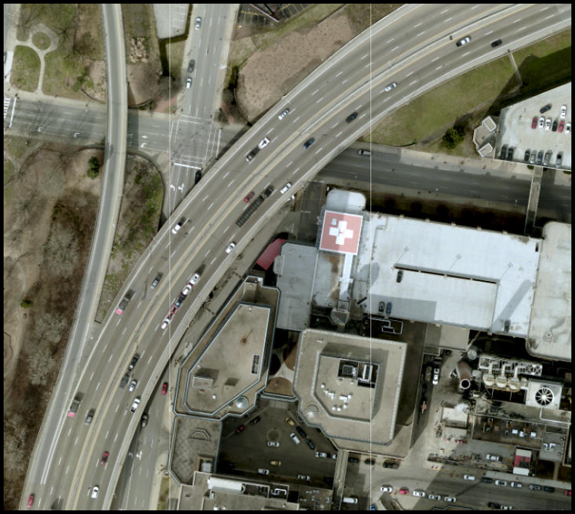
I-65 Central Corridor Setting | Medical District

Slide 14
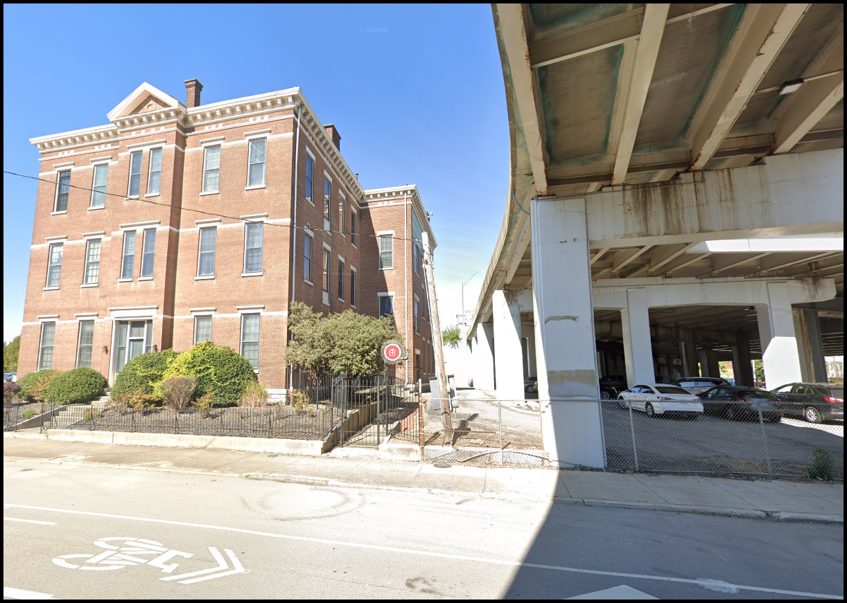
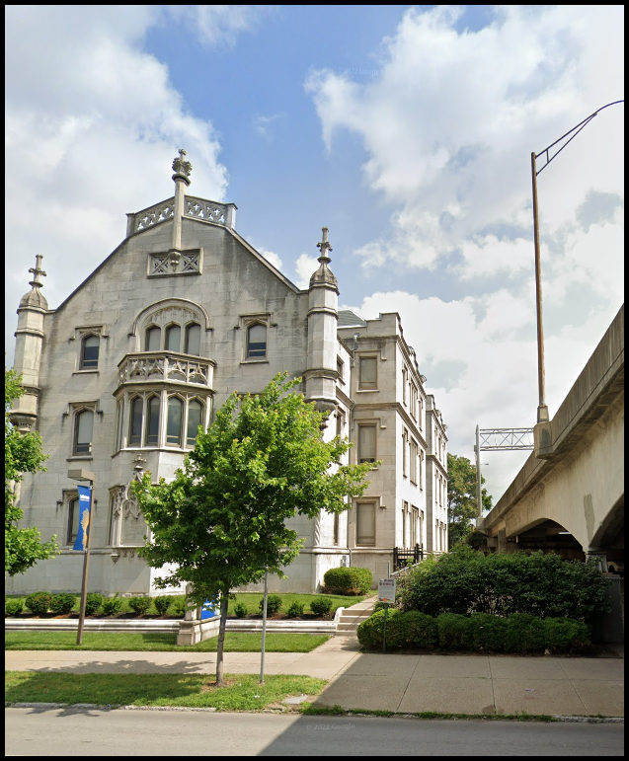
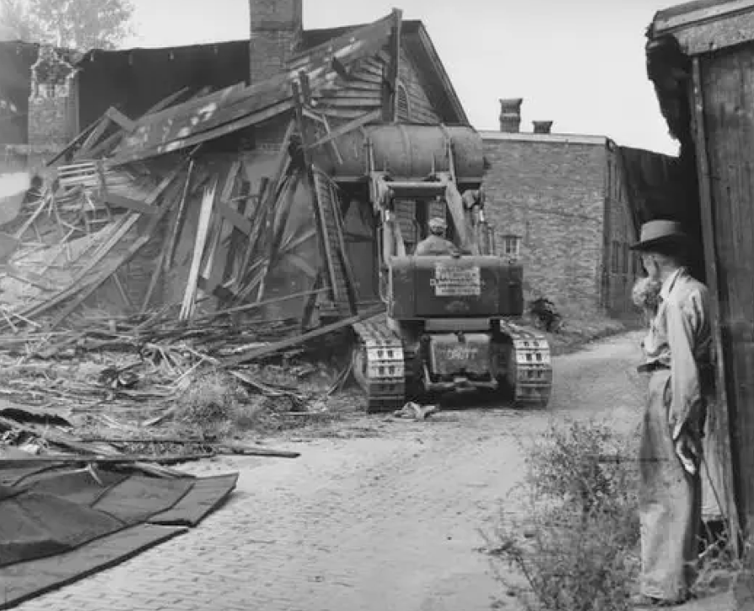
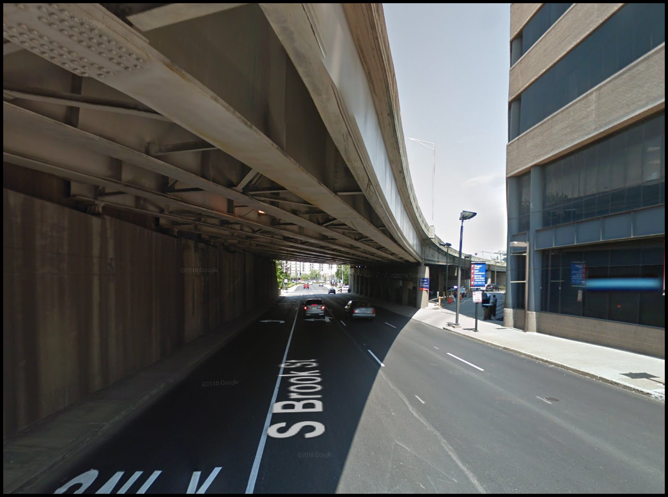
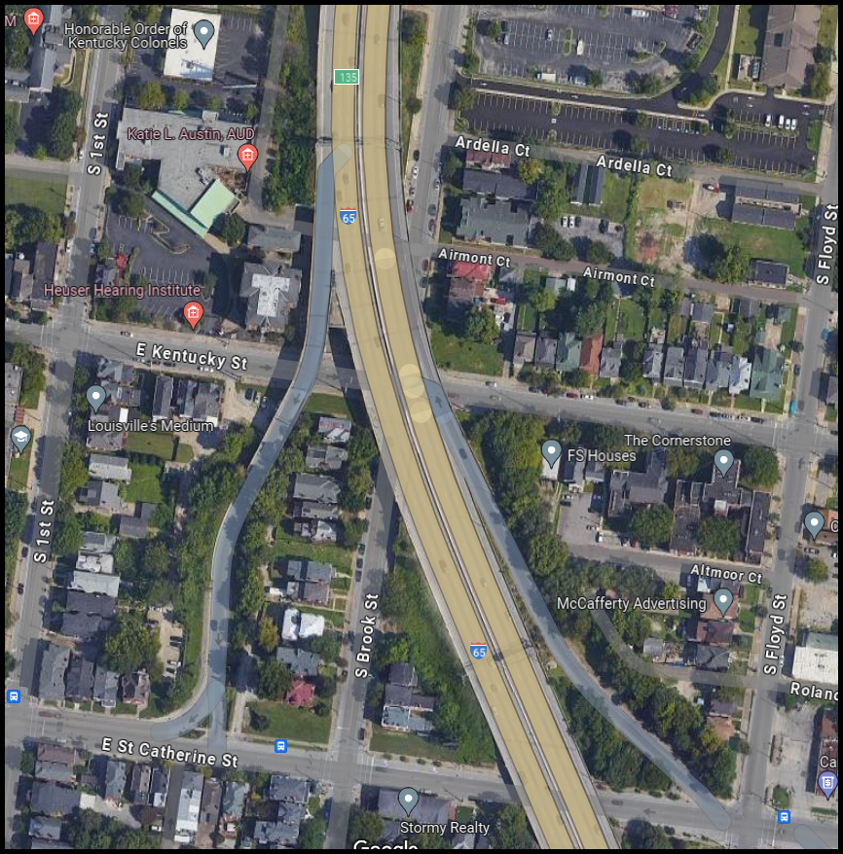
I-65 Central Corridor Setting | Dense Urban Corridor

Slide 15
Tackling the Challenges
Preconstruction Coordination

Slide 16
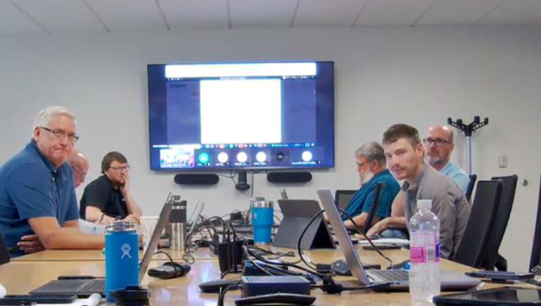
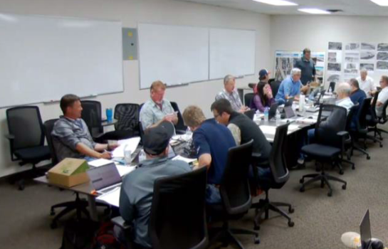
Challenge | Preconstruction Coordination Meetings
Design Task Force Meetings
Weekly Design Task Force Meetings (Tues/Fri)
Weekly Risk/Estimate Coordination Meetings (GEC/ICE)
Bi-Weekly Geotech Meetings
Bi-Weekly ROW Meetings
30% / 60% / 90% Pricing Milestone Meetings
Constructability Review Meetings
Quantity/Cost Reconciliation Meetings

Slide 17
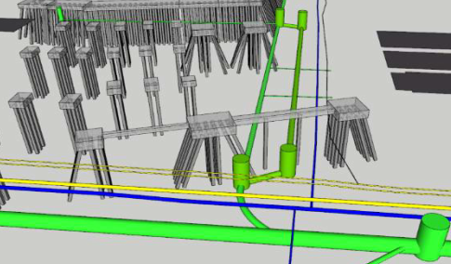
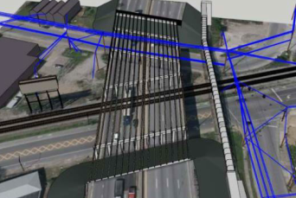
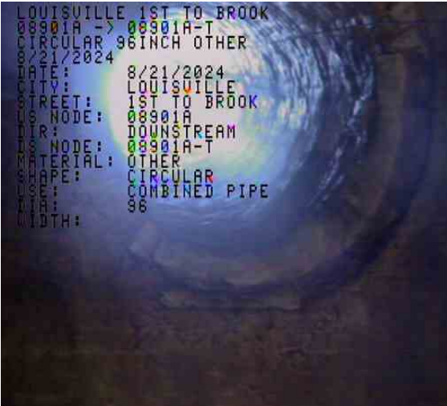
Challenge | Preconstruction Coordination Meetings
Early Utility Coordination Meetings
Monthly Utility Meetings
Potholing/SUE
Video Inspection
    96” Combined Sewer
    108” Combined Sewer
Early Utility Relocation Packages

Slide 18
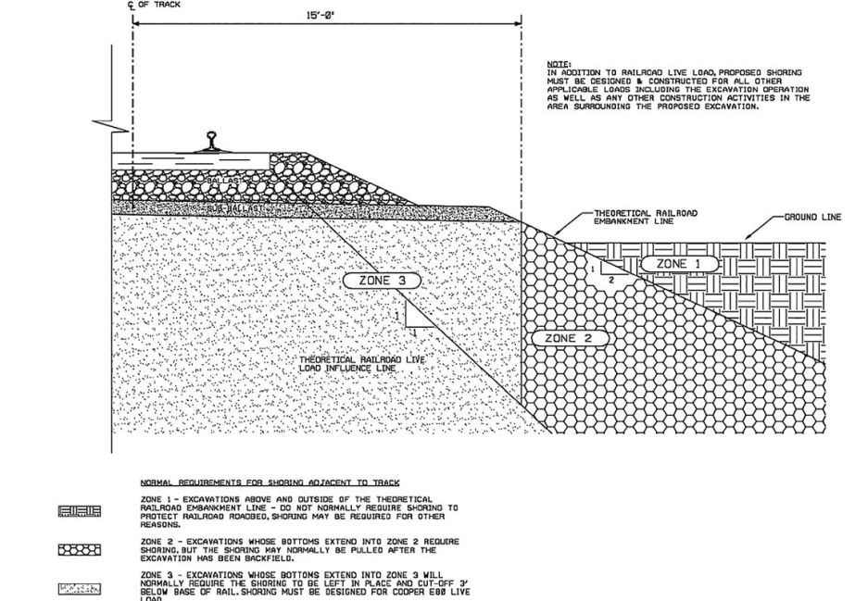
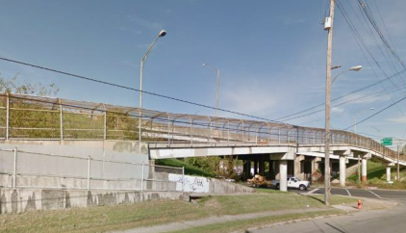
Challenge | Preconstruction Coordination Meetings
Early CSX Coordination Meetings
CSX Bi-Weekly Meetings
Collaboration on design progression avoided challenges such as:
  Influence zone for shoring
  Replacement of pedestrian bridge

Slide 19
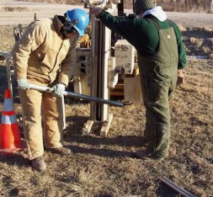
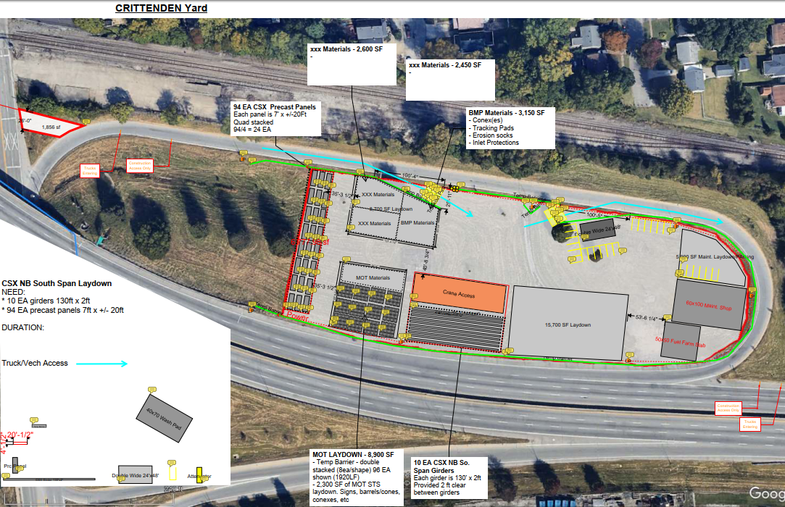
Challenge | Preconstruction Coordination Meetings
Early identification of Staging Areas/ Laydown Yards / Excess Excavation
Allowed NEPA Integration
Conducted advanced HAZMAT Sampling & Soil Characterization
Coordinated for Right of Way acquisition
Improved construction productivity

Slide 20
Tackling the Challenges
MOT Planning and Design

Slide 21
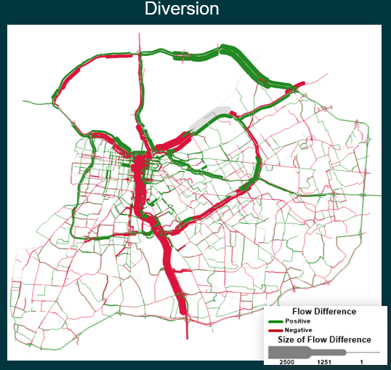
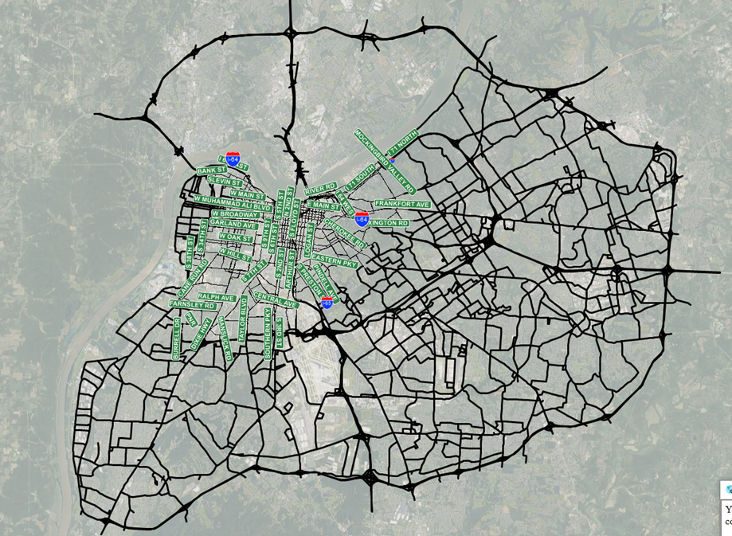
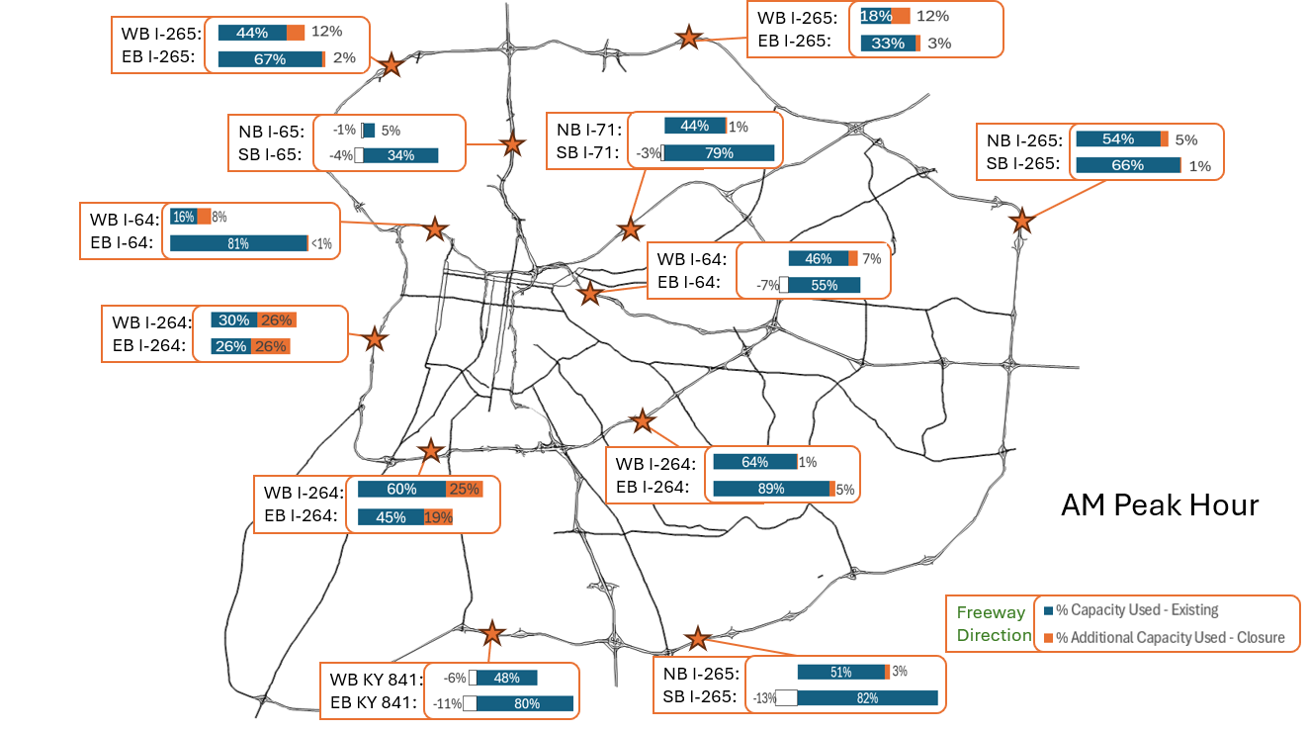
Challenge | MOT Planning and Design
Transmodeler Regional Model
Calibration
Alternatives Analysis
  Multiple construction scenarios
Results
  Volumes, LOS, Delay, Queuing & Travel Times
Origin-Destination Analysis
  10 locations- AM/PM
  Truck O/D
  No major increase in delay for most O/D routes (<10 minutes)
Identified Mitigation Locations
Notes:
Question- which first- bridge closure approach or traffic approach to see if we could close it?
Could we close it?- Transmodeler runs- ID’d where traffic would go . AM and PM peaks (3 hour window), identified/highlighted some areas/hotspots/bottleneck areas –
Mitigations -

Slide 22
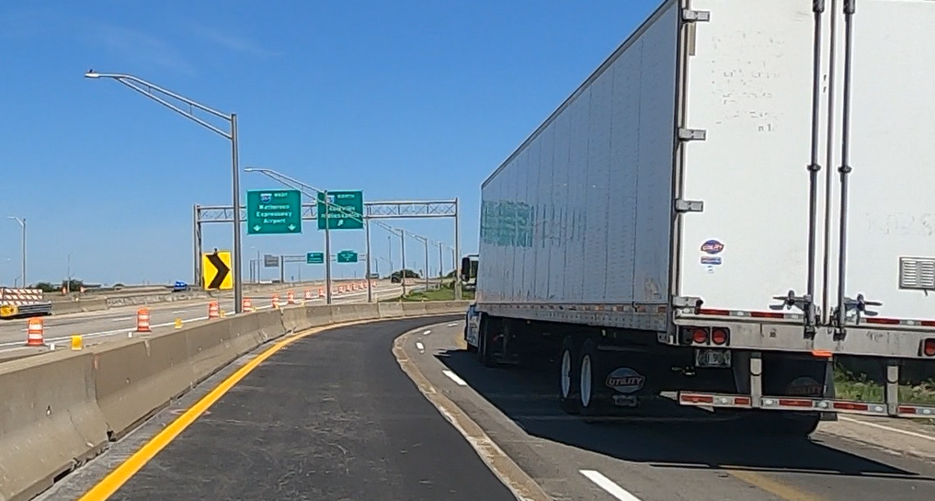
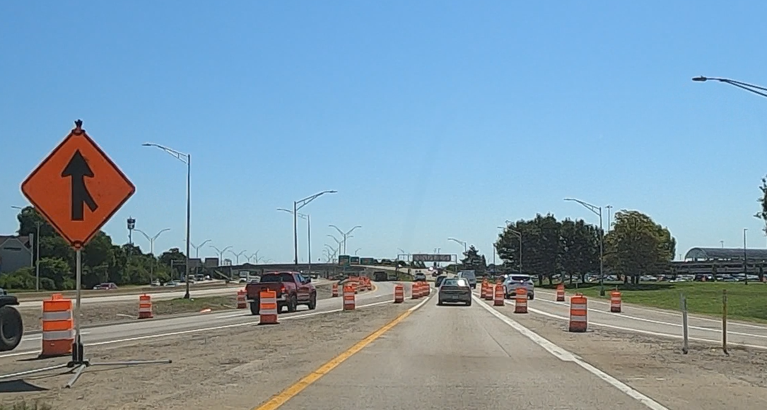
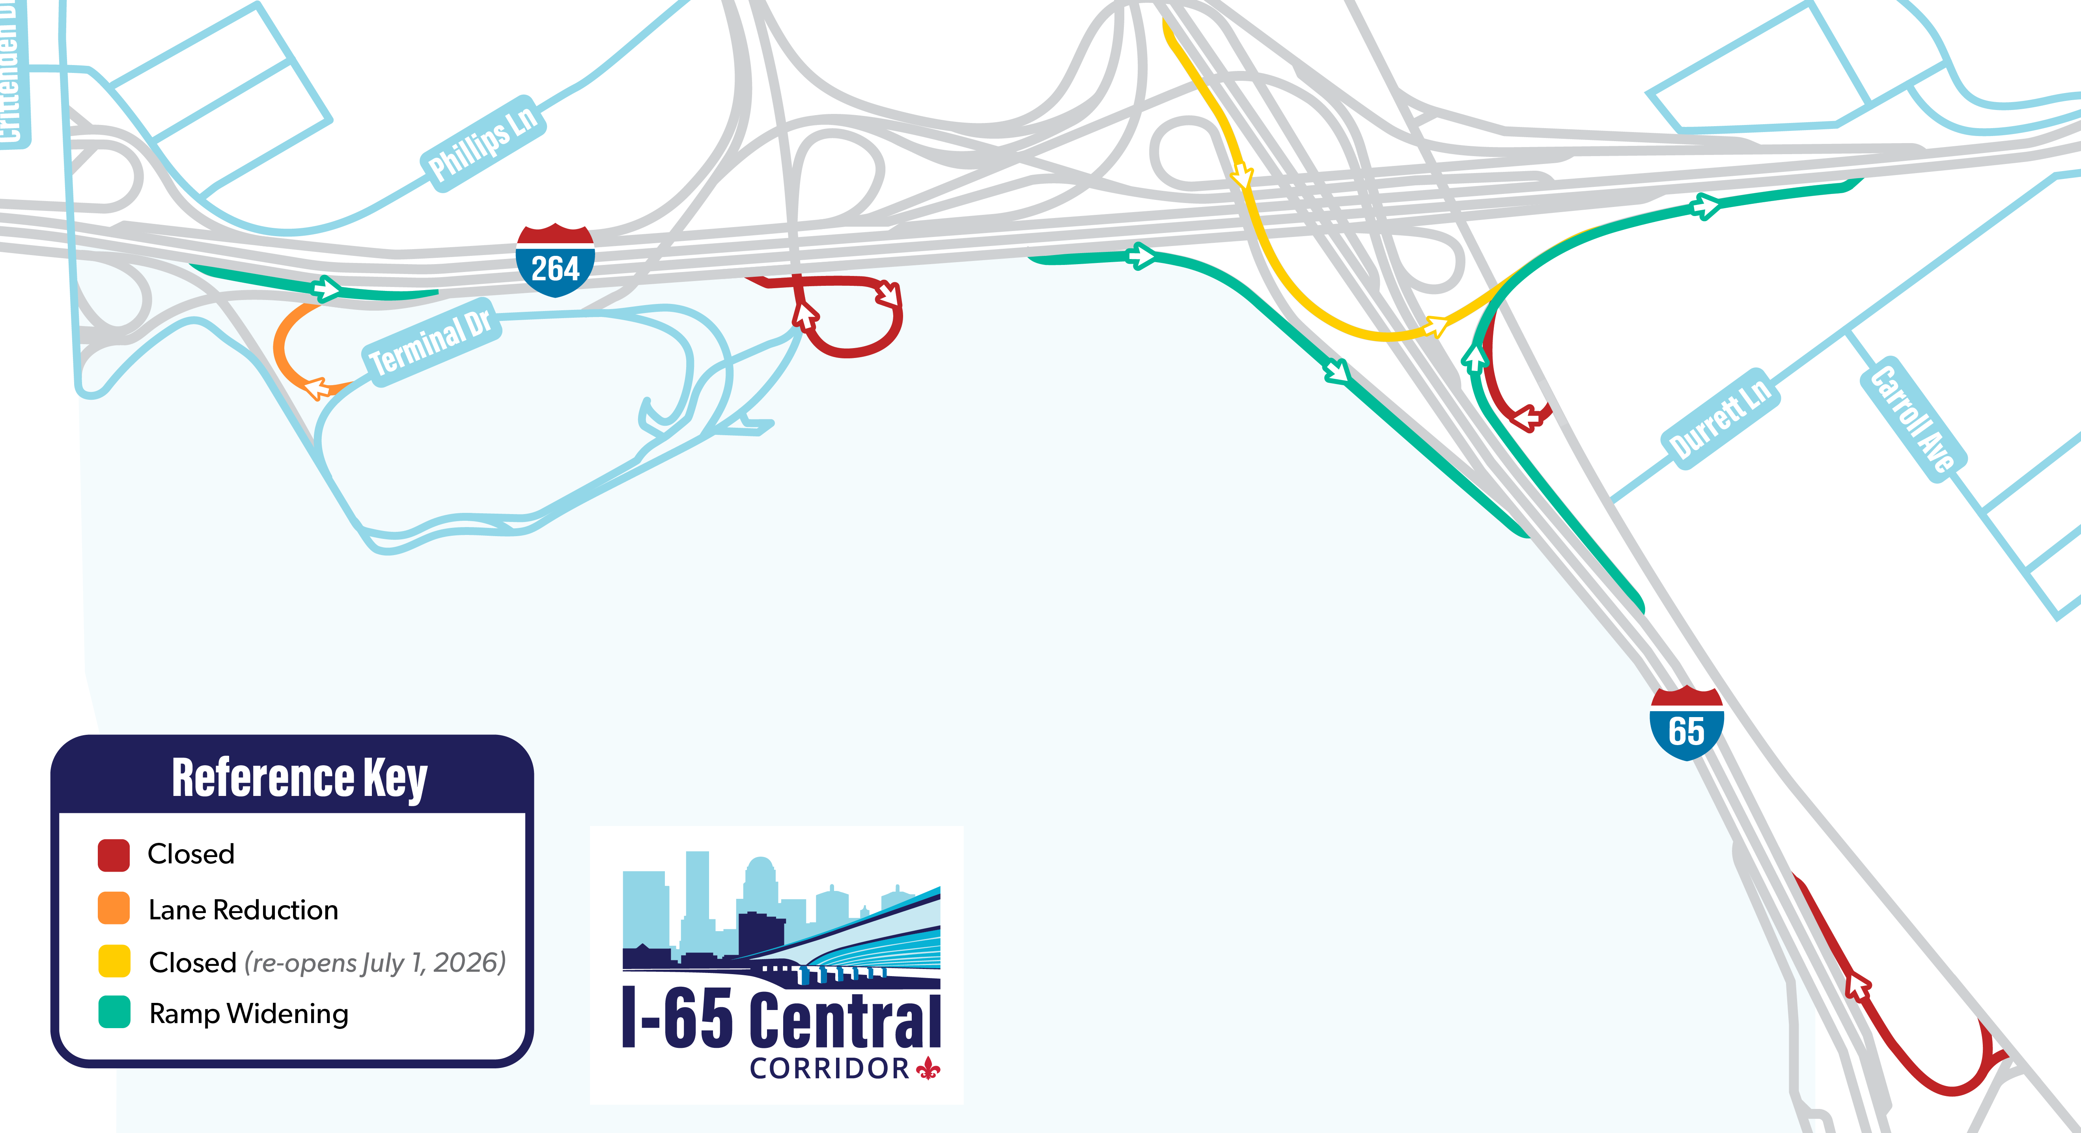
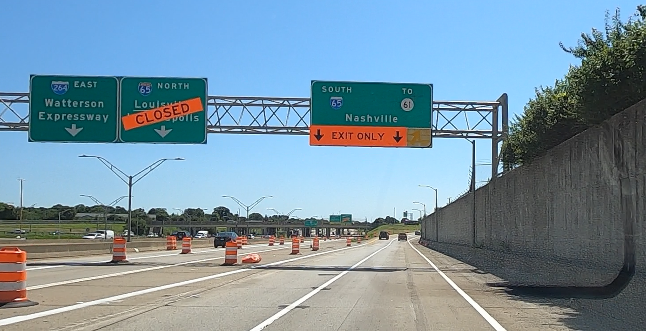
Challenge | MOT Planning and Design
Off-Site Safety/Capacity Mitigations
Temporary Ramp / Lane Closures
  Addresses Weaving concerns
Temporary Ramp Widening
  Additional Capacity
I-65 Project Website
https://i65centralcorridor.com
Notes:
Question- which first- bridge closure approach or traffic approach to see if we could close it?
Could we close it?- Transmodeler runs- ID’d where traffic would go . AM and PM peaks (3 hour window), identified/highlighted some areas/hotspots/bottleneck areas –
Mitigations -

Slide 23
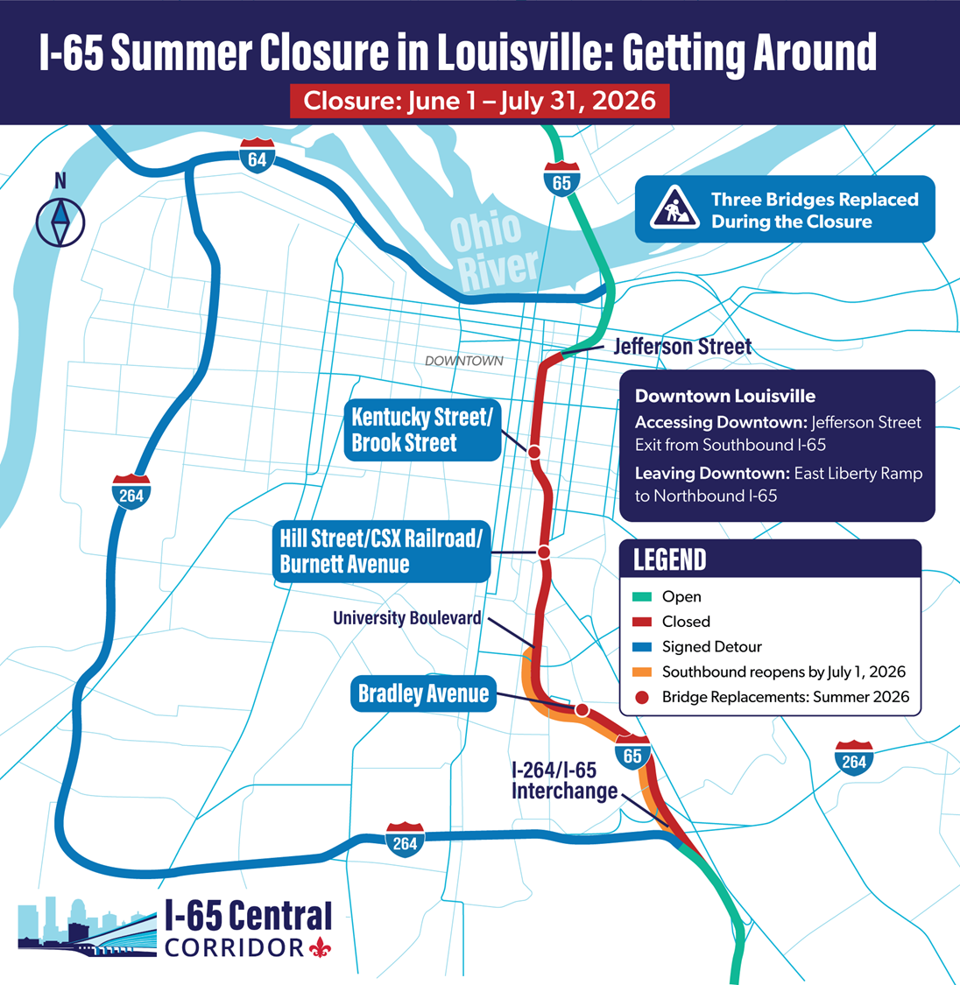
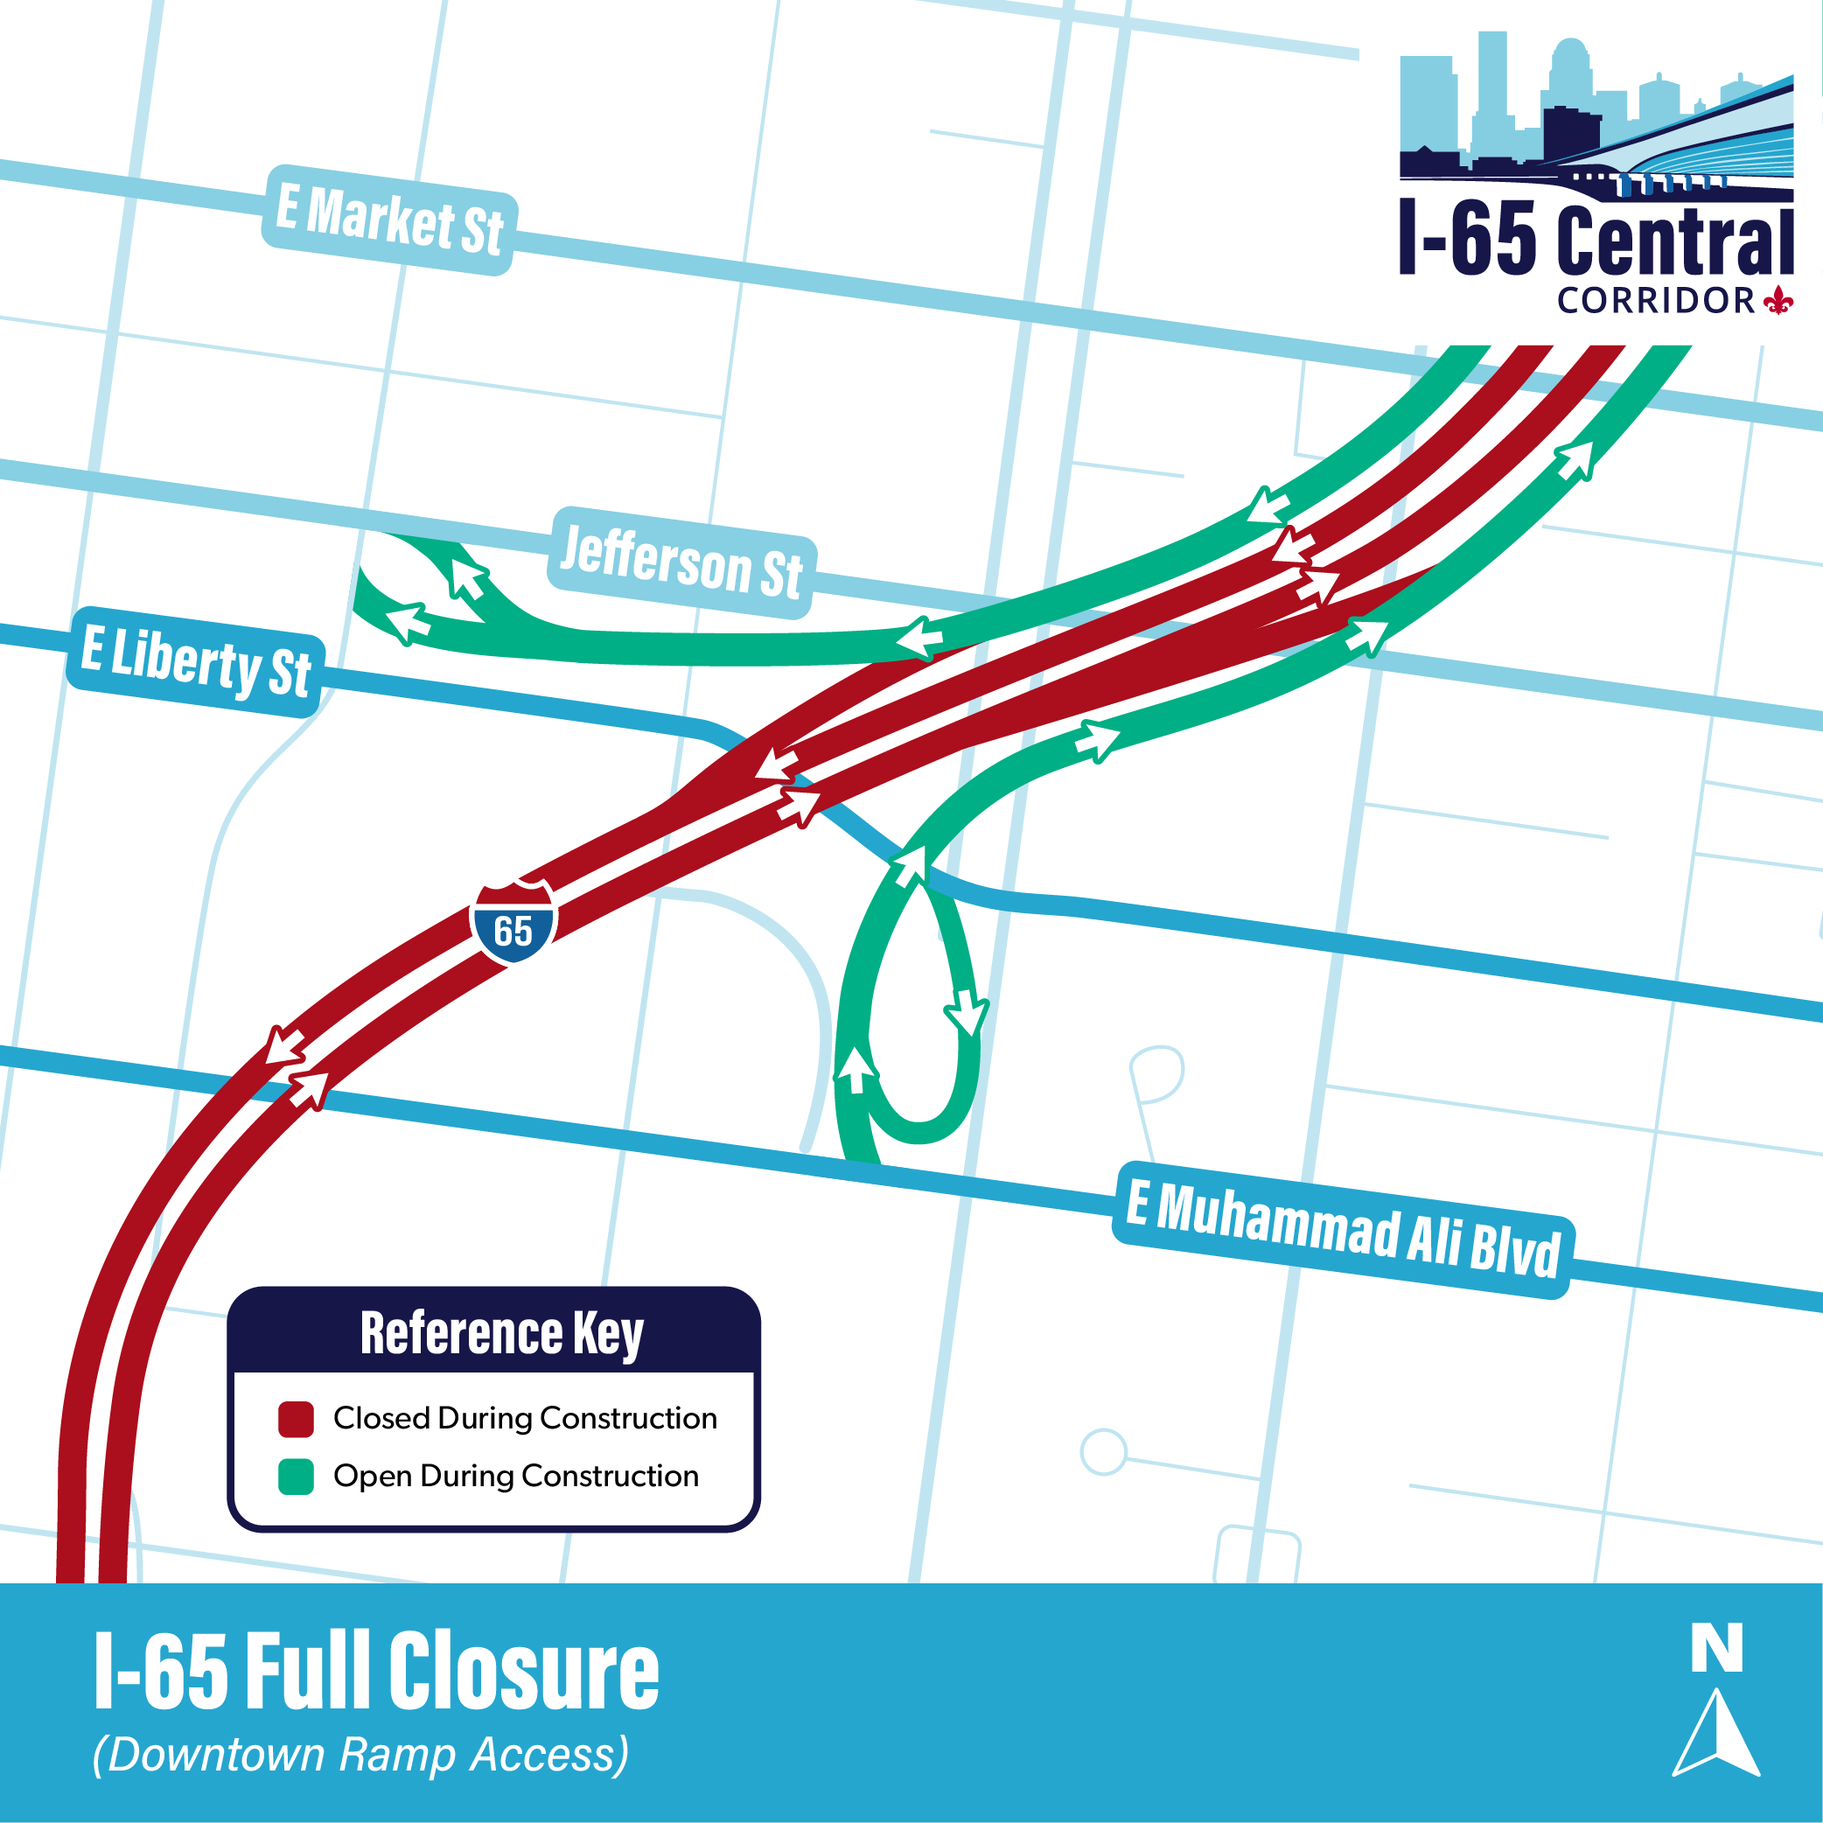
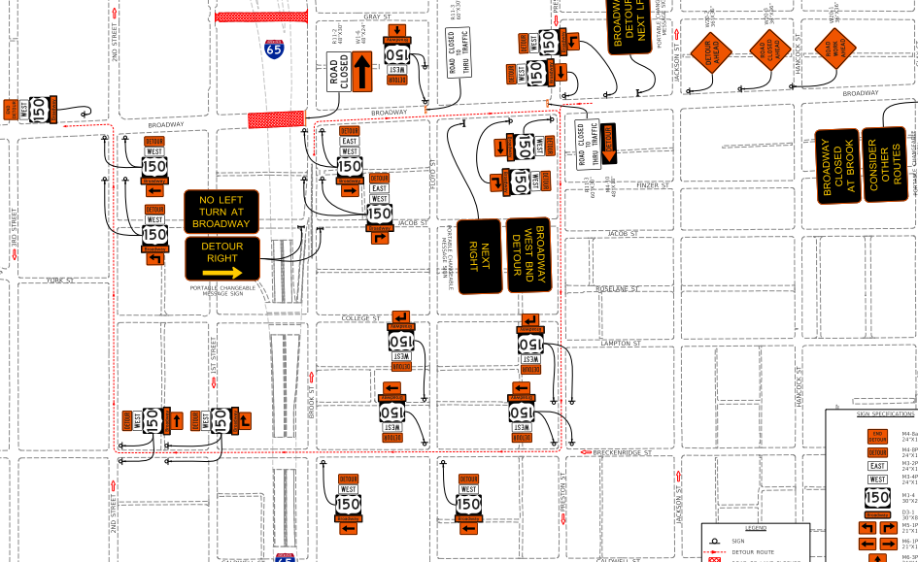
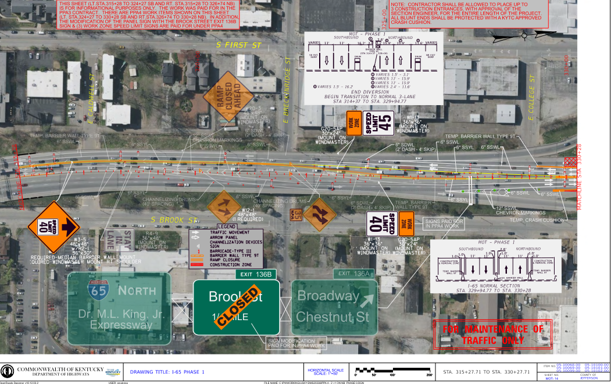
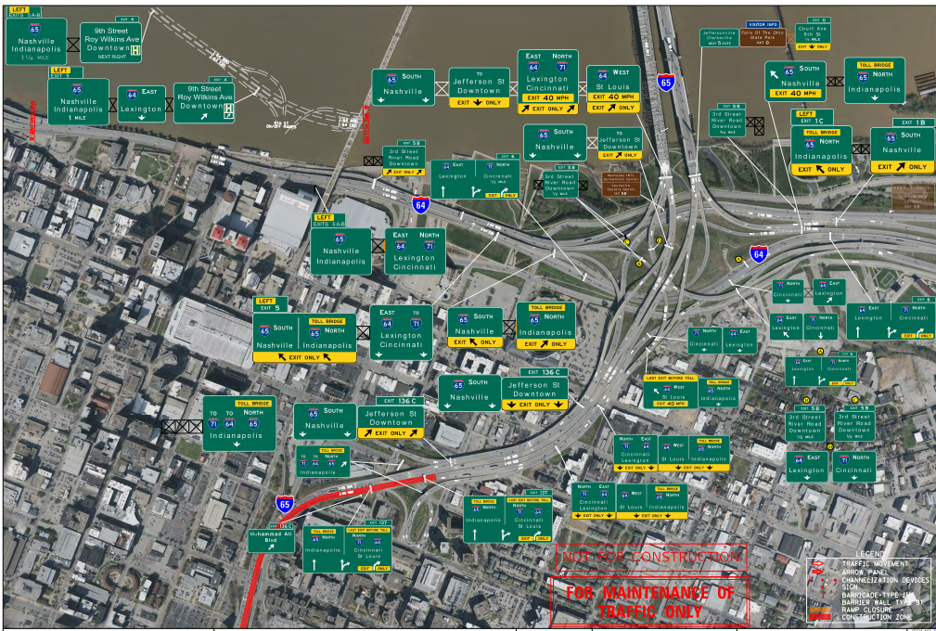
Challenge | MOT Planning and Design
  SIGNED DETOUR
  Through traffic detoured to WB I-264 (Georgia Davis Powers Expressway)
  on west side of Louisville
    Utilize most available capacity
    Create least traffic impacts
    Downtown Access
    Surface Street Detours – Vehicular and Pedestrian
I-65 Project Website
https://i65centralcorridor.com

Slide 24

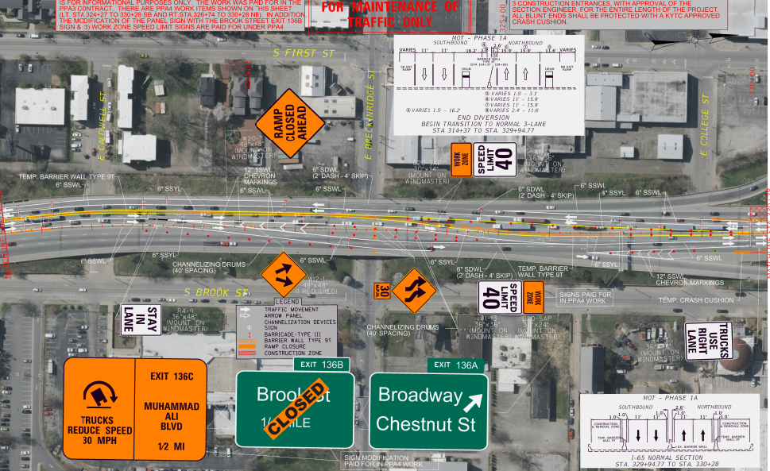
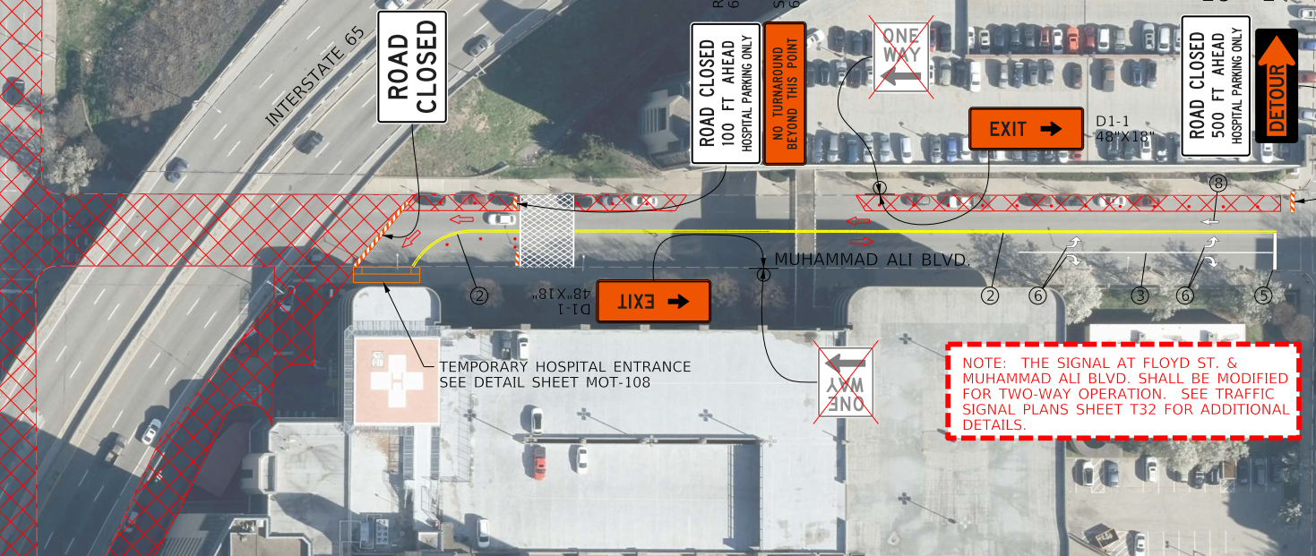
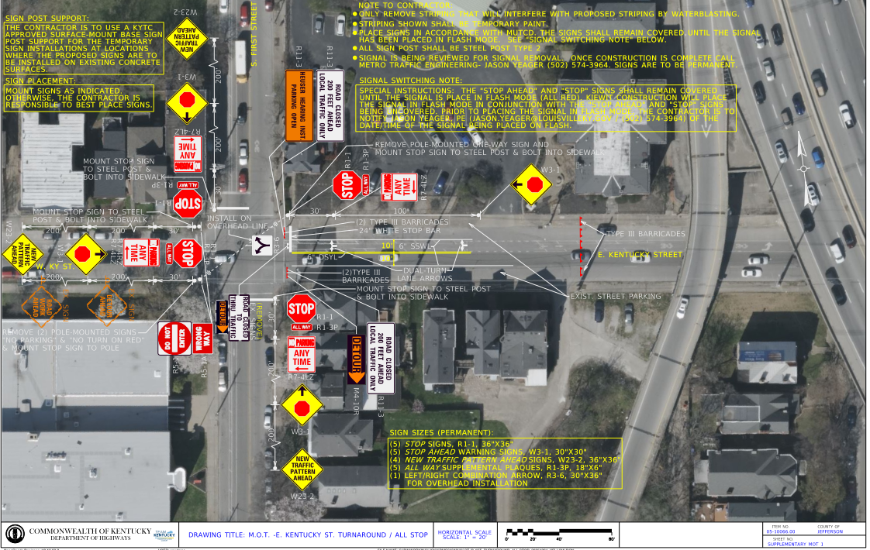
Challenge | MOT Planning and Design
Pre-Construction Planning
Speed limit reduction to 40 mph (SHE Approval
Truck lane restrictions
Regional Variable Message and TRIMARC signing
2-Way Street Conversions
Hospital Parking Garage Access
Notes:
Question- which first- bridge closure approach or traffic approach to see if we could close it?
Could we close it?- Transmodeler runs- ID’d where traffic would go . AM and PM peaks (3 hour window), identified/highlighted some areas/hotspots/bottleneck areas –
Mitigations -

Slide 25
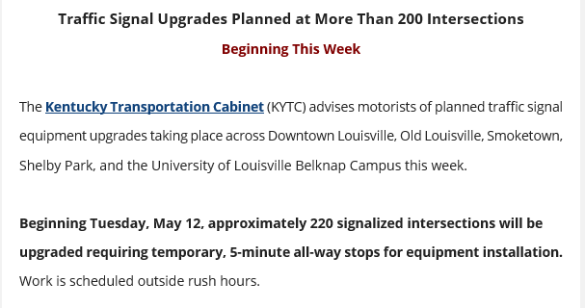
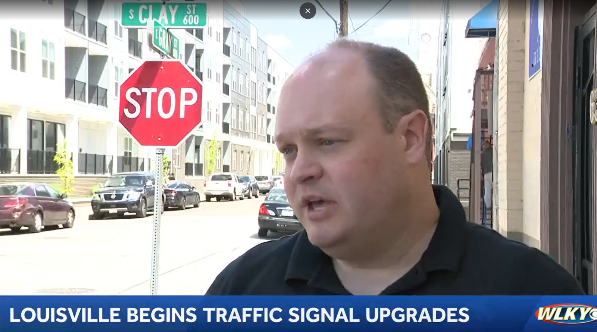
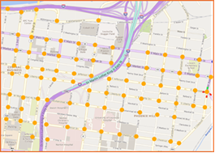
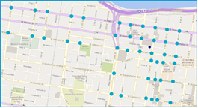
Challenge | MOT Planning and Design
Pre-Construction Agency Coordination
KYTC / Louisville Metro Partnership
  Coordination with Traffic Signal Controller Updates (220)
  Signal Timing Updates
  Special thanks to Brandon Shelley and Stacy Keith & Jason Yeager at Louisville Metro
Notes:
Question- which first- bridge closure approach or traffic approach to see if we could close it?
Could we close it?- Transmodeler runs- ID’d where traffic would go . AM and PM peaks (3 hour window), identified/highlighted some areas/hotspots/bottleneck areas –
Mitigations -

Slide 26




Challenge | MOT Planning and Design
Full Closure – Week 1 Adjustments
Coordination with navigational apps (WAZE, Google, Apple)
MUST BE FLEXIBLE AND AVAILABLE DURING WEEK 1

Slide 27





Challenge | MOT Planning and Design
Can opener at 3rd Street (https://www.louisvillecanopener.live/ )

Slide 28
Tackling the Challenges
Complex Bridge Design

Slide 29


Challenge | Complex Bridge Design
Bridge Maintenance Project
9 Bridges Released For Construction
  3 Bridge Rehabilitations
  6 Bridge Replacements
Project Goals:
  Replace Aging Infrastructure
  Reduce Future Maintenance Needs
Innovations At Every Turn!

Slide 30



Challenge | Complex Bridge Design
Accelerated Bridge Construction
Under bridge work
Micropiles
LWCC
Precast Deck Panels

Slide 31


Challenge | Complex Bridge Design
CSX/Hill St./Burnett Ave.
    Railroad Vertical Clearance
    Link slab design
    Bridge Deck Reduction
Bradley Avenue
    Bridge conversion to wagon box
    Meeting KFEC’s Needs

Slide 32



Challenge | Complex Bridge Design
    Kentucky St./Brook St.
      Complicated Geometry
      Minimal Vertical Clearance
      Redundant Steel Straddle Bents

Slide 33


Challenge | Complex Bridge Design
Jacob St./Broadway/Gray St. & Chestnut St.
    Extreme Bridge span reduction
      33 Span to 3 Single Spans
    MSE Supported Roadway Plugs
    Substructure Reuse

Slide 34



Challenge | Complex Bridge Design
Brook St./Muhammed Ali Blvd.
  (Hospital Curve)
    “Maintenance Nightmare”
    Complicated Geometry
    Robust FEA Model (LARSA)
    Substructure reuse and chloride mitigation
    Bridge deck reduction

Slide 35
Tackling the Challenges
Closing the Interstate

Slide 36




Closing the Interstate
COMMUNICATION IS KEY
Stakeholder Engagement
Media Events
Social Media
Website
Public Meetings
Digital Message Signs
Radio Advertisements
Billboards

Slide 37

Closing the Interstate
SUCCESS FACTORS
Early railroad coordination
Advance sewer relocation
Early steel procurement
Laydown yard access
Reduced bridge deck area
Utilized precast concrete deck panels

Slide 38


Precast Concrete Deck Panels

Slide 39


Precast Concrete Deck Panels

Slide 40

Closing the Interstate
CHALLENGES
Overhead Utilities
Limited Right-of-Way
Noise & Vibration
  Micropiles
  Vibration Monitoring
Detoured Interstate Traffic
  Incident Management Coordination
  Quick Clearance
Weather
Notes:
Can Opener, increased train traffic, random pedestrians on the interstate

Slide 41


Closing the Interstate
MAINTENANCE OPPORTUNITIES
Wrong Way Project
Roadway Sweeping
Drain Cleaning
Tree Trimming
Pothole & Bridge Deck Patching
Overhead Panel Sign Replacements
I-65 CC Surveying & Coring
TRIMARC Camera Repairs
Localized Repair Projects
Notes:
Can Opener, increased train traffic, random pedestrians on the interstate

Slide 42


Bradley Avenue

Slide 43


Bradley – Deck Area Reduction
CURRENT CONCEPT
PLANNED CONCEPT

Slide 44

Bradley – Old Bridge

Slide 45

Bradley – Pre-Closure

Slide 46

Bradley – New Bridge

Slide 47

Hill Street,
CSX Railroad & Burnett Avenue

Slide 48

Hill/CSX/Burnett – Old Bridge

Slide 49

Hill/CSX/Burnett – Closure

Slide 50

Hill/CSX/Burnett – Closure

Slide 51

Kentucky & Brook Streets

Slide 52

Kentucky/Brook – Closure

Slide 53

Kentucky/Brook – Closure

Slide 54

Questions?

